Slide 1
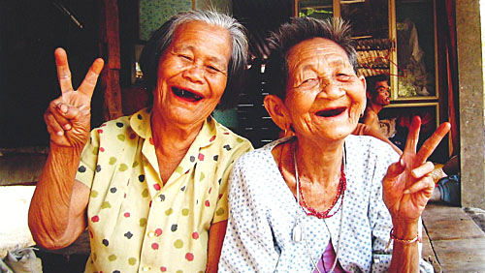
Why is Thailand known as “The Land of Smiles”?

Slide 2
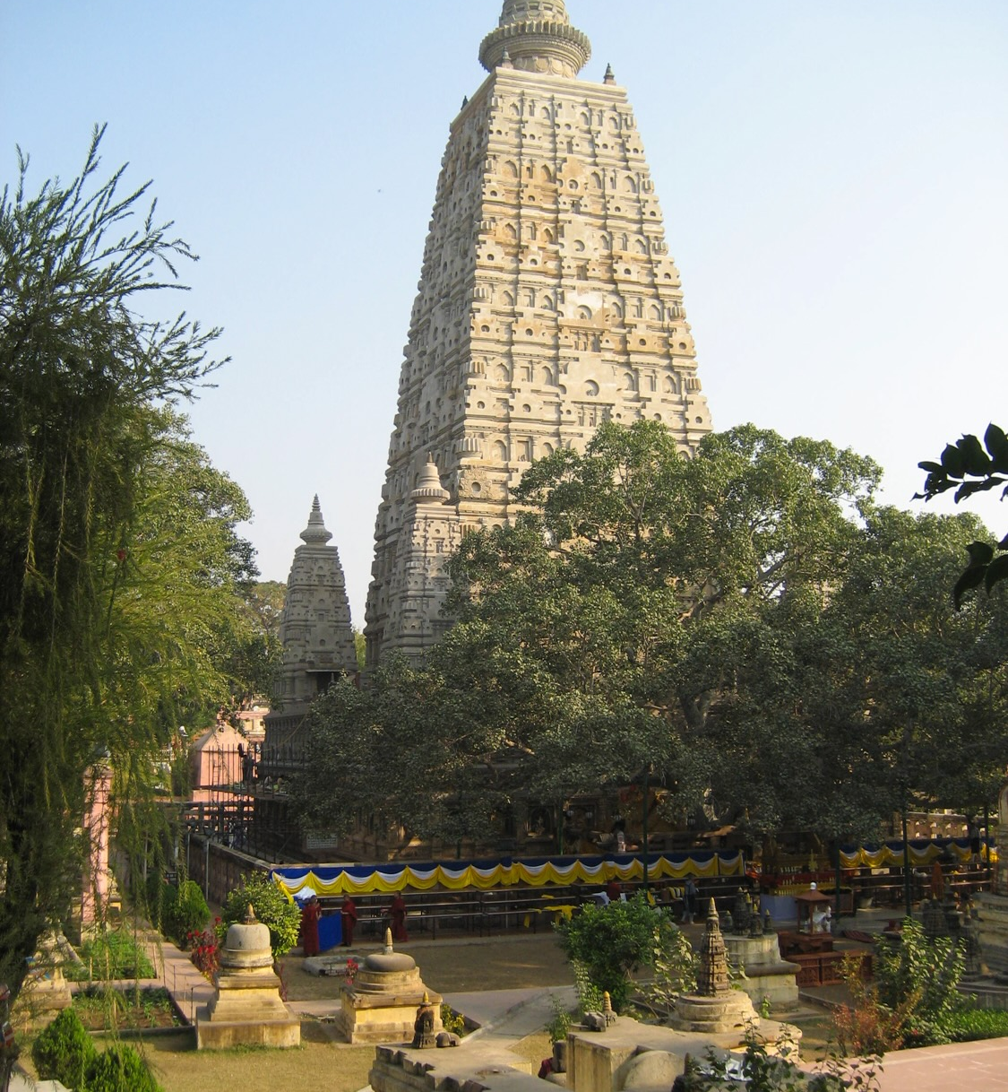
Buddhism Begins in
India
Buddhism has its origins in ancient India
where Siddhartha Gautama,
later known as Buddha, attained
enlightenment (nirvana). His teachings
spread across India, especially during
the reign of Emperor Ashoka (3rd century
BCE) who embraced Buddhism.
Ashoka sent missionary monks
to Thailand.
Title
Mahabodhi Temple is built on
the site where Buddha attained
enlightenment in India.
(Chodron, 2001), (Kusalasaya, 1983).

Slide 3
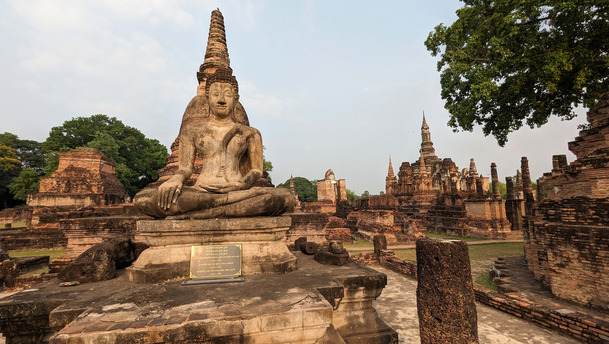
The Sukhothai Kingdom is known as the
“Cradle of Thai Civilisation.” It embraced Buddhism.
("Sukhothai Timeline -World History Encyclopedia").
Buddhism spreads to Thailand.

Slide 4
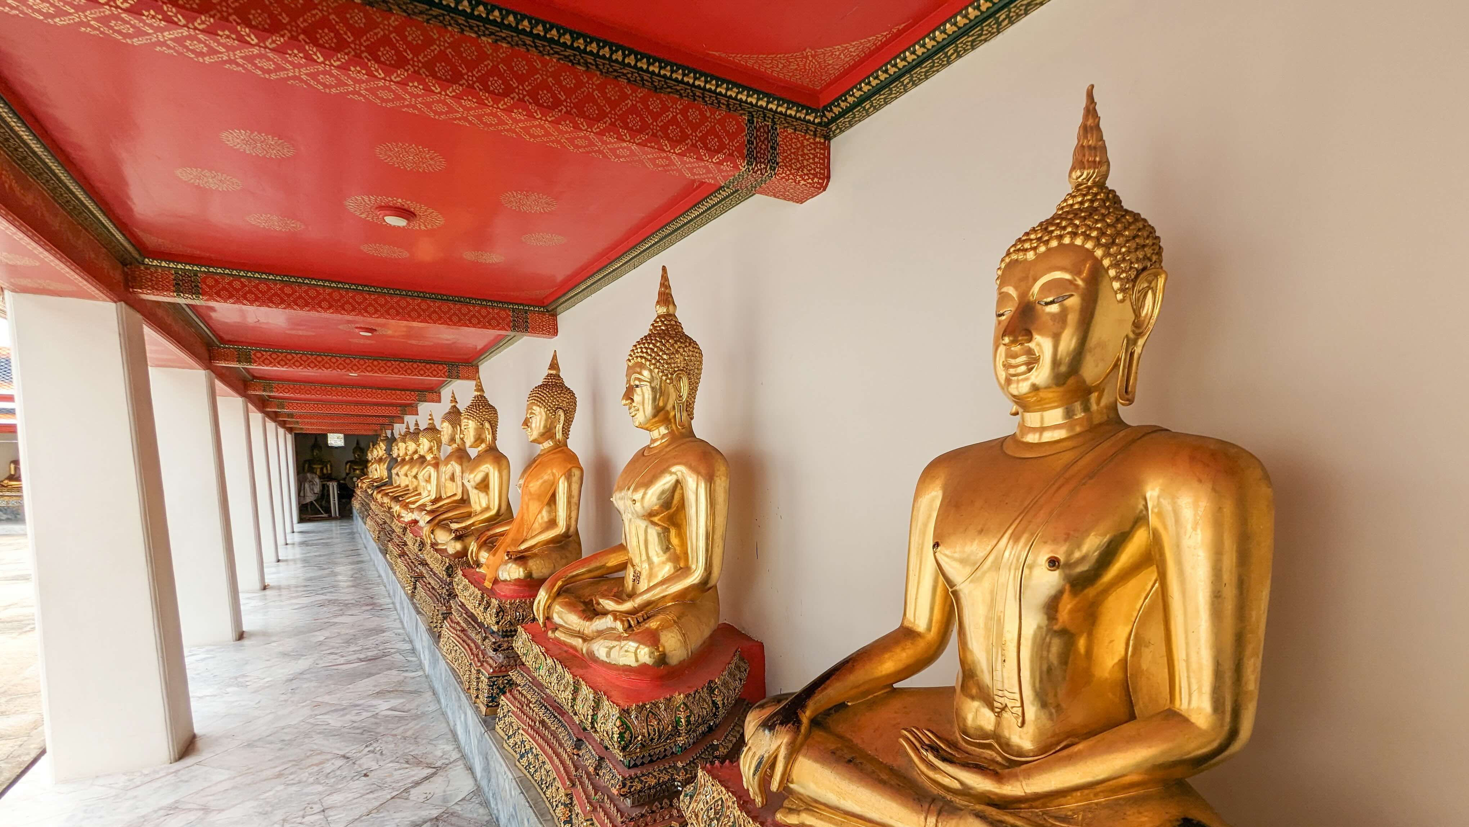
Buddhism in Thailand Today
Roughly 94% of Thai people identify as Buddhists.
Many young men become Buddhist monks at some point in their lives.
(BOI : The Board of Investment of Thailand), (“Buat Nak: Rituals before Monkhood – Thailand Foundation”)
Buddhism is a major infuence in Thai society.

Slide 5
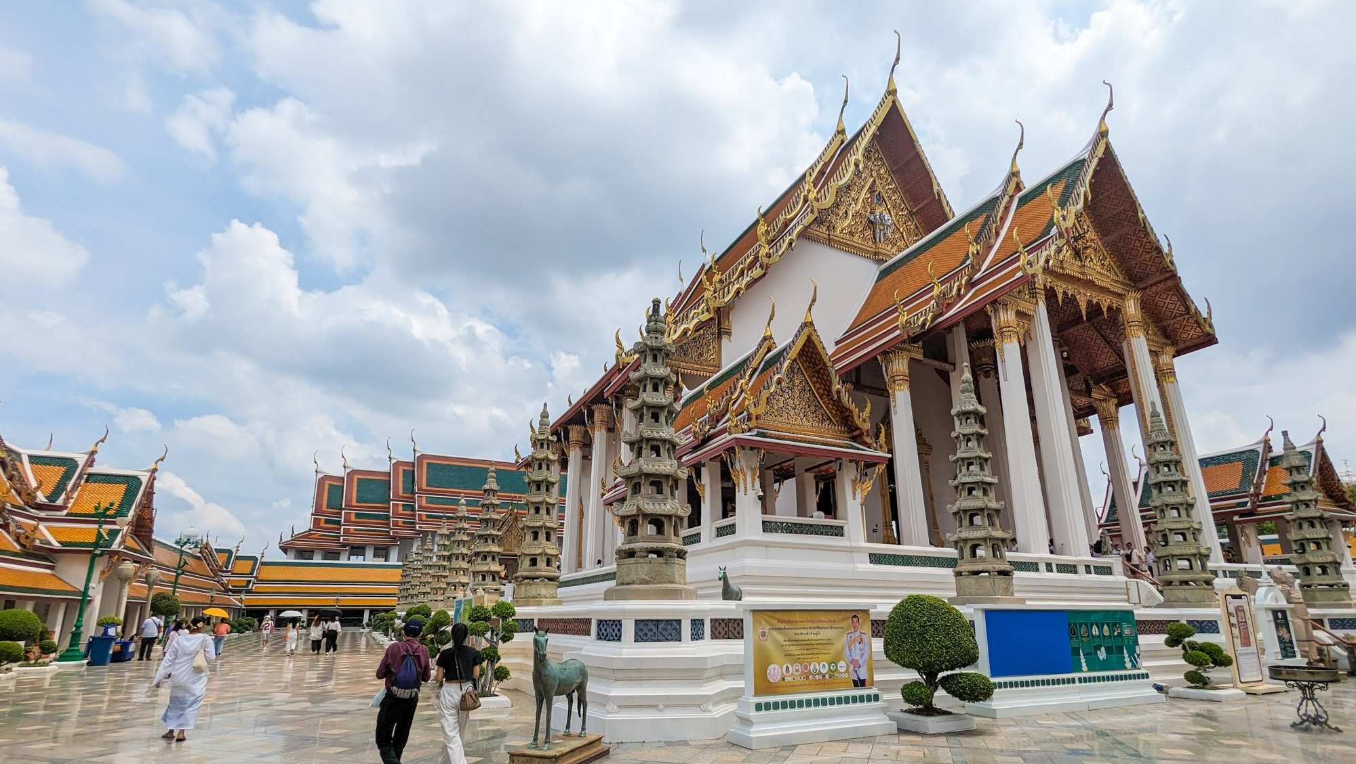
There are roughly 43,000 Buddhist temples in Thailand.
Buddhism is very important to Thai people.
(“Thailand: Number of Buddhist Temples | Statista”)

Slide 6
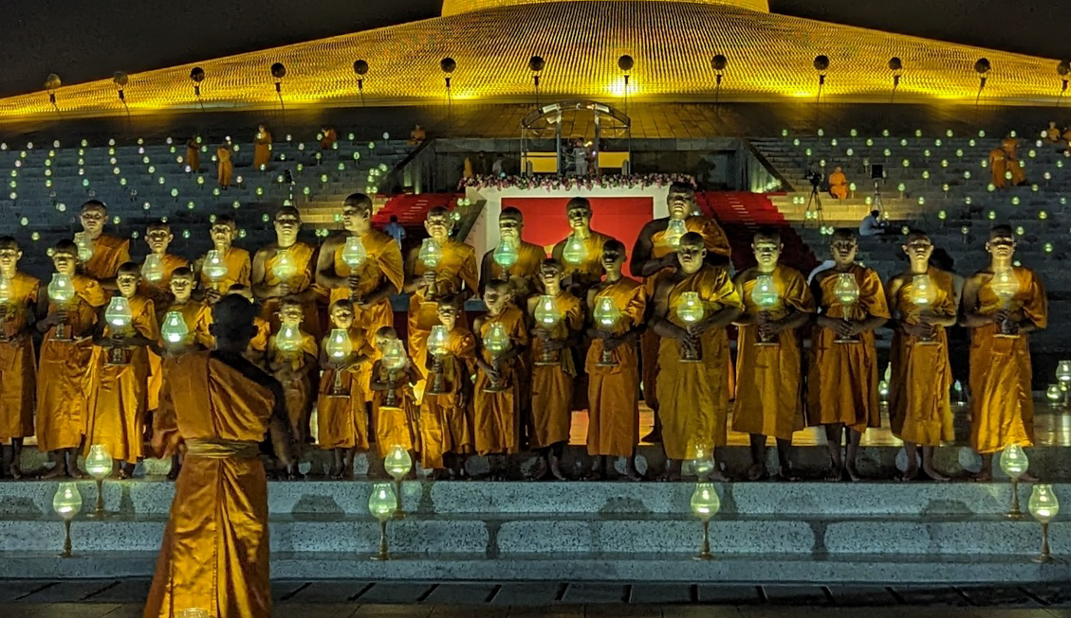
Vesak and Magha Puja
Two of the most sacred Buddhist festivals in Thailand.

Slide 7
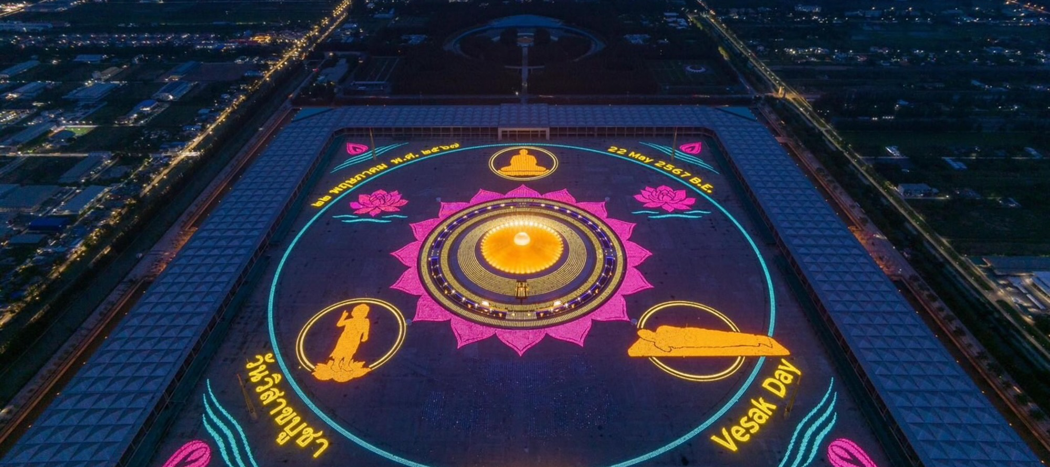
Various activities and actions occur during Vesak and Magha Puja, especially in and around temples and shrines. They are a time for Thai Buddhists to reflect on and celebrate Buddha’s teachings and life.

Slide 8
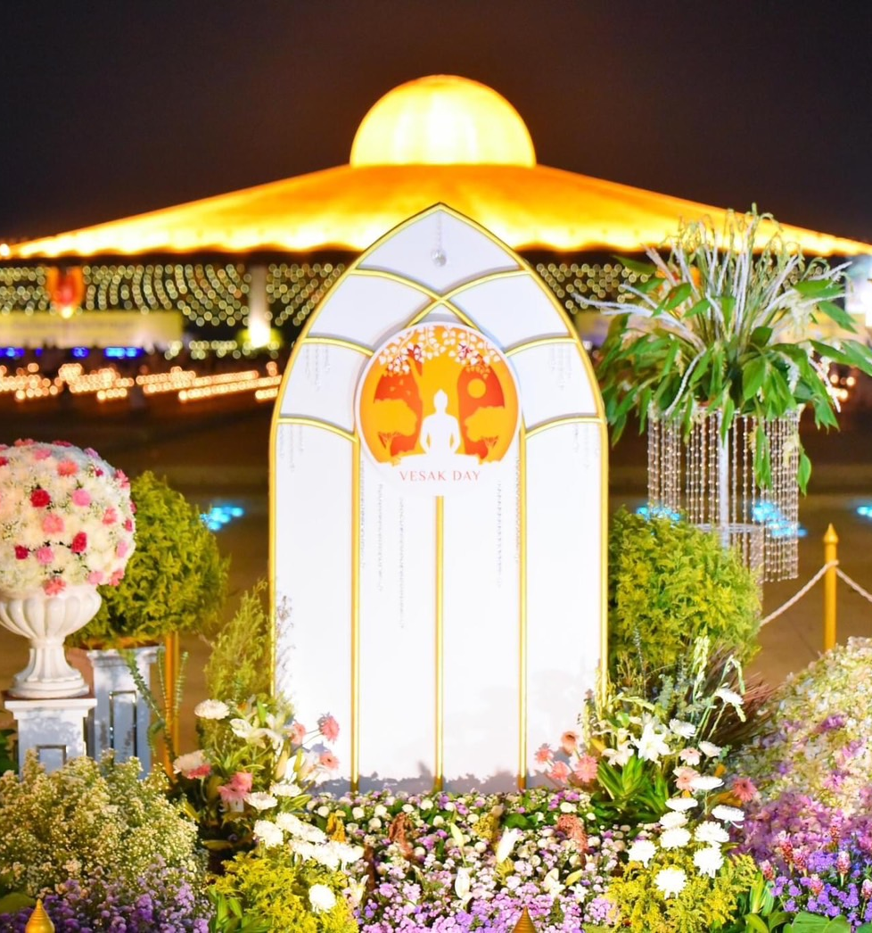
What is Vesak?
Vesak is a day that Buddhists
celebrate the birth,
enlightenment (nirvana),
and the passing of Buddha
(parinirvana).
It is the most sacred day for
Buddhists around the world.
(“Vesak - Buddhism for Beginners | Tricycle: The Buddhist Review”).

Slide 9
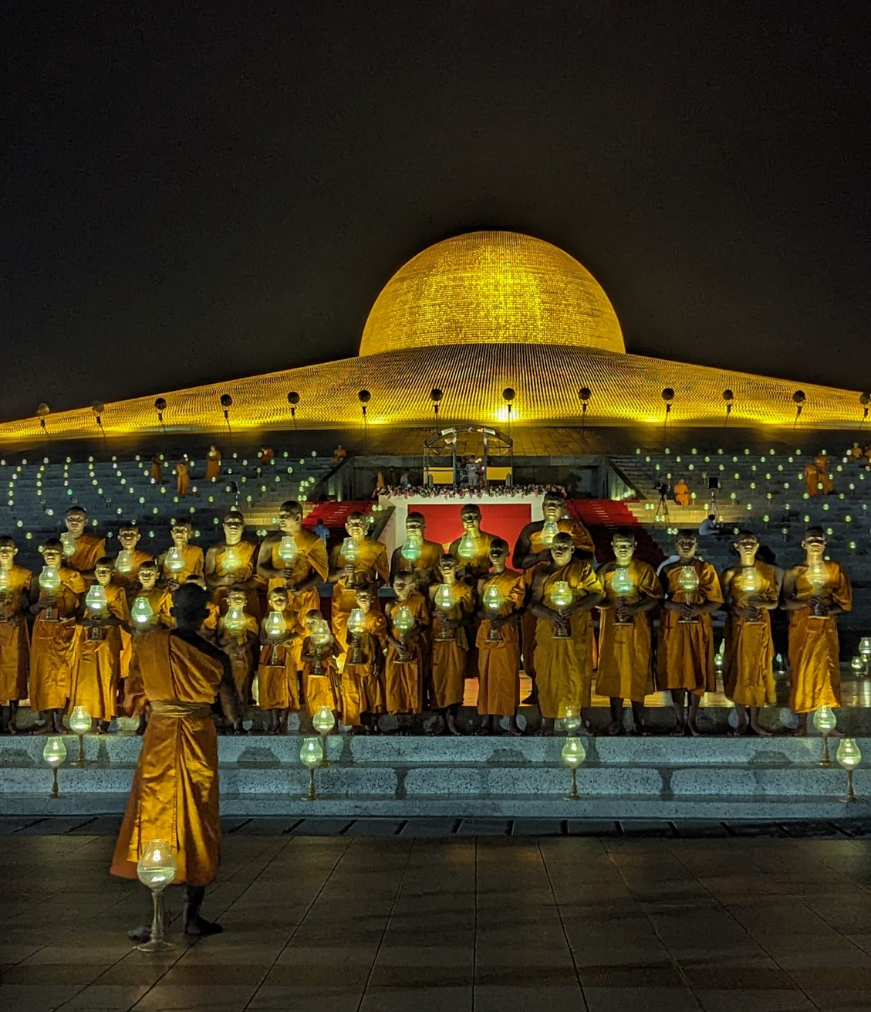
What is Magha Puja?
On Magha Puja Buddhists celebrate
the gathering of Buddha and 1,250
enlightened disciples and the
teaching he gave them. He taught
three of the core principles in
Buddhism:
“To avoid all evil,
To cultivate good,
And to cleanse ones mind.”
(O’Brien, 2008), (The Dhammapada, 2010).

Slide 10
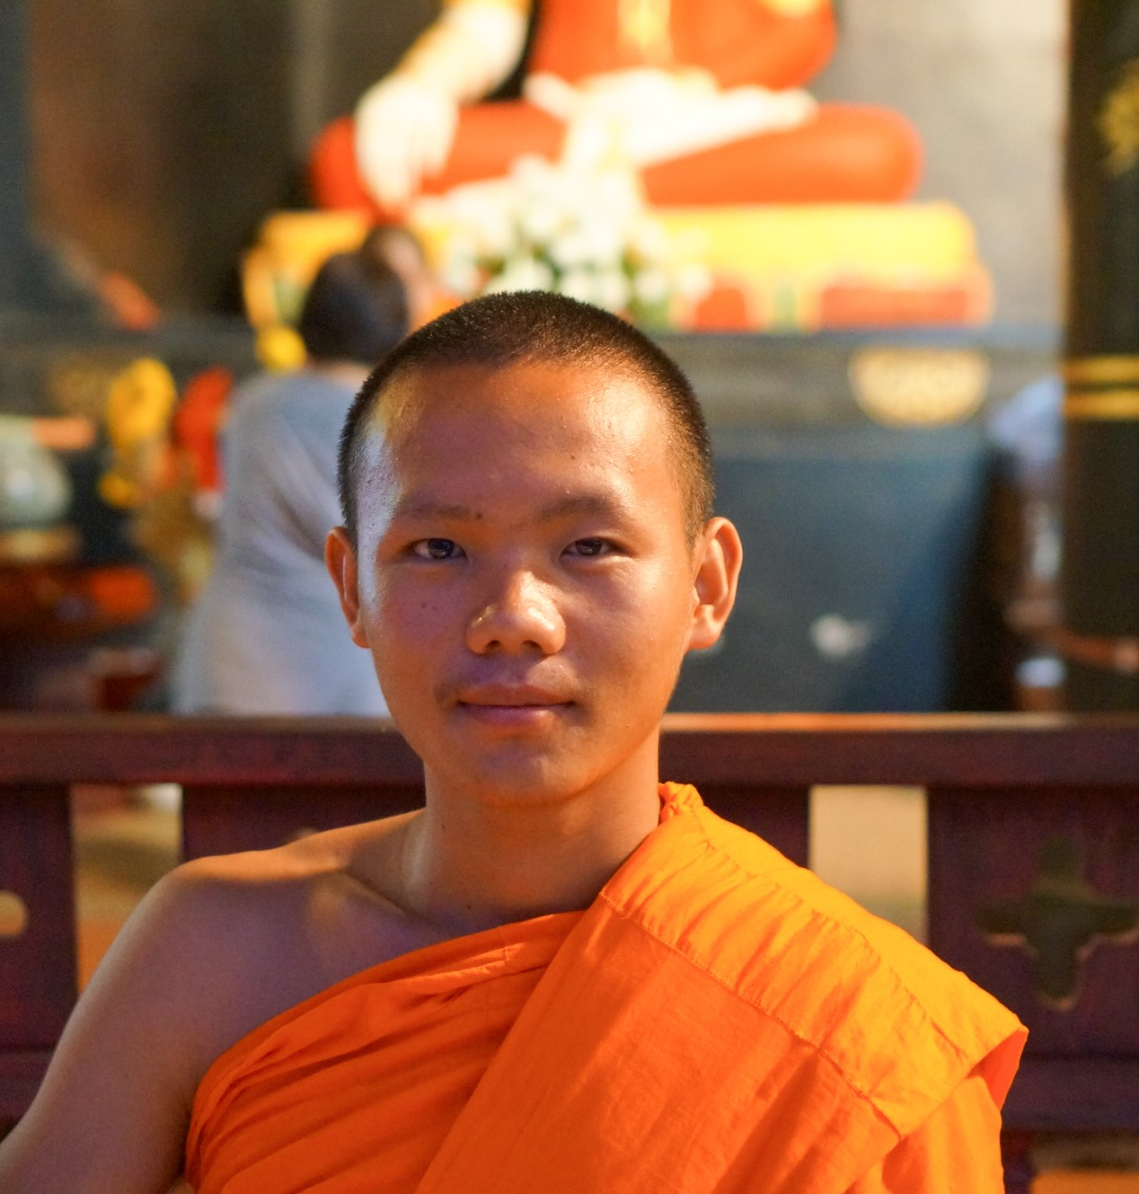
Making Merit
Being generous. People practice
generosity more on these festivals.
Giving alms to monks, such as
food and other daily necessities.
Giving to charity. Helping the poor
and other charitable causes.
Being vegetarian for the day. Not
harming living beings is a principle
of Buddhism.
(Songkaeo, 2024), (“The Practice of Almsgiving in Buddhism”, 2023).

Slide 11
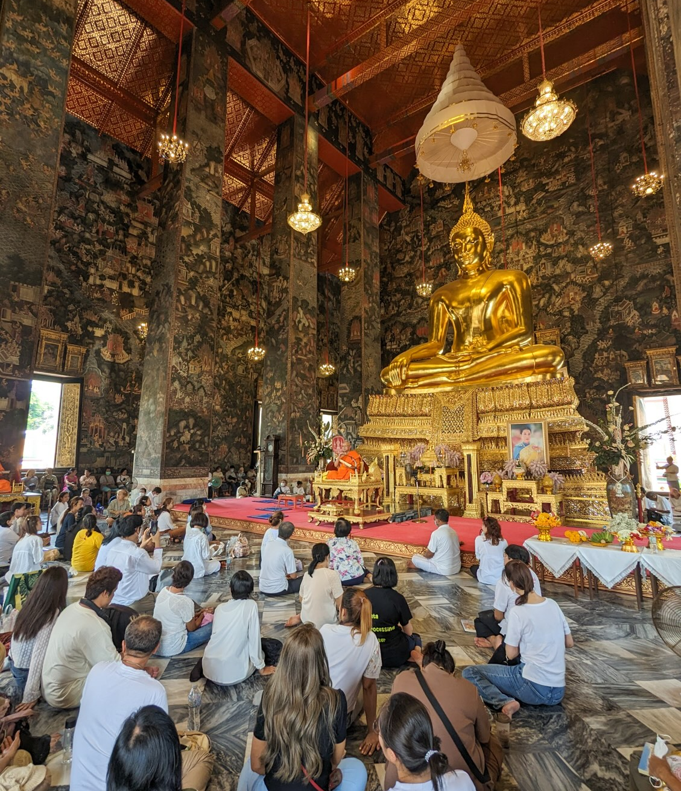
Visiting Temples
Listen to Dhamma (sermons). Hear
monks teaching Buddha’s wisdom.
Listen to chants. Monks will chant
from Buddhist scriptures.
Participate in ceremonies. Joining
in reciting Buddhist verses.

Slide 12
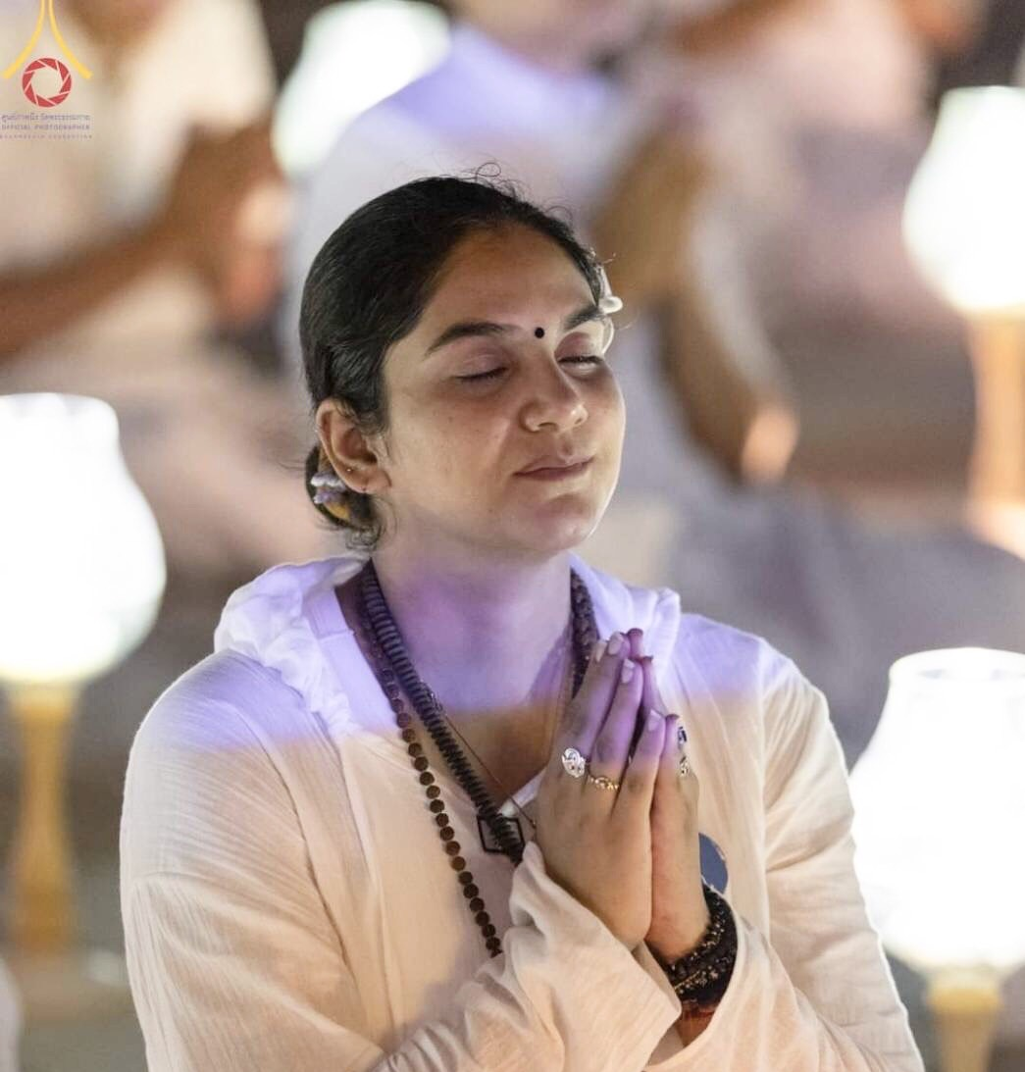
Meditation
Meditate on the teachings of
Buddha during these festivals.
Send positive energy to all people
in the world in your meditations.
Group meditations in temples
for collective energy.
(Hanh).

Slide 13
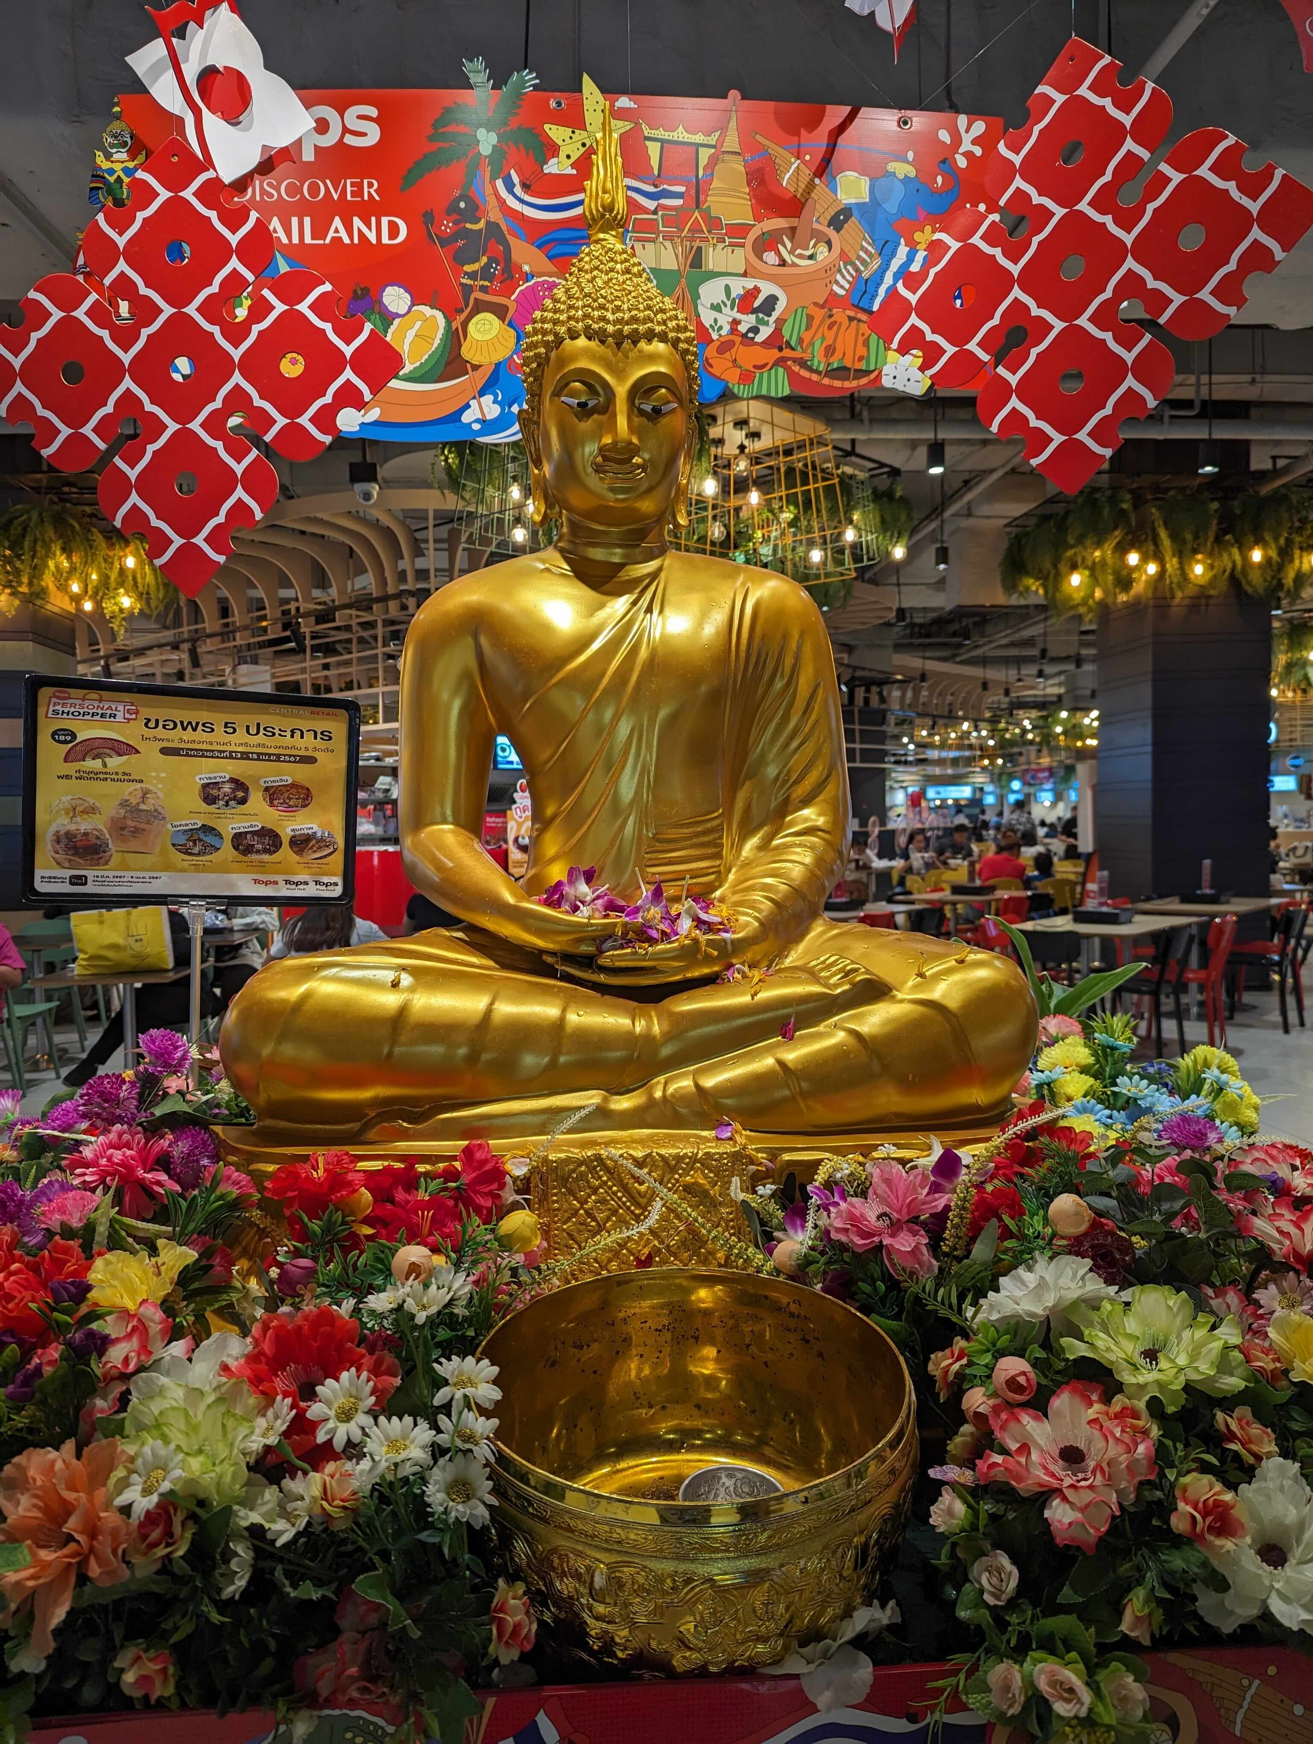
Bathing Buddha
People bathe statues of Buddha on
Vesak with water to purify the
mind and body. It is a way to cleanse
yourself spiritually.
These statues can be found in many
places, not just in temples.
(“The Spirit of Practice During the Buddha’s Birthday Celebration (Vesak) – Deer Park Monastery”).

Slide 14
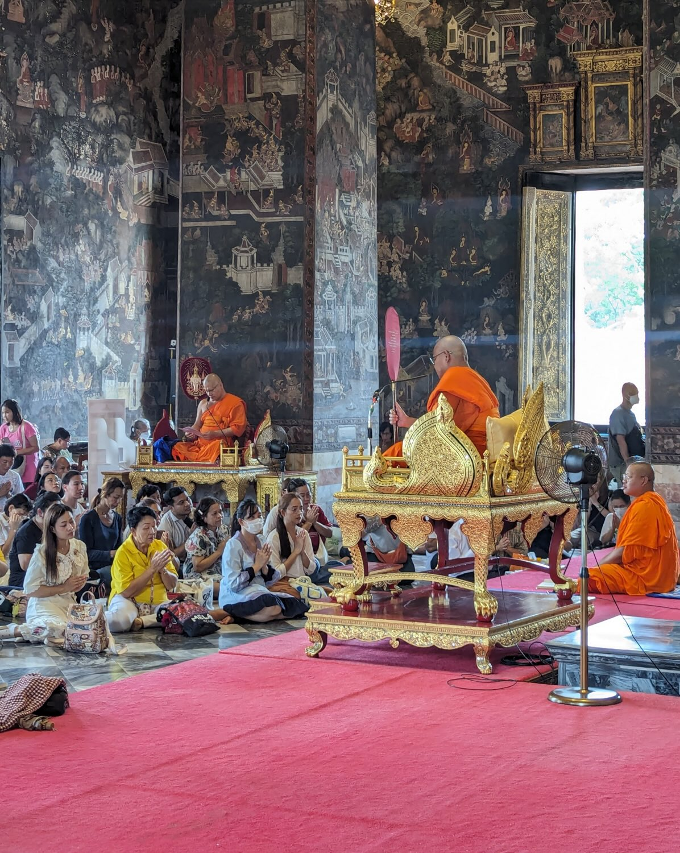
Observing The 5 Precepts
The five precepts are an ethics code
for laypeople to follow. They are:
Do not harm living beings.
No Stealing.
No sexual misconduct.
No lying.
No intoxication (Alcohol, etc).
(Landaw et al, 2019).

Slide 15
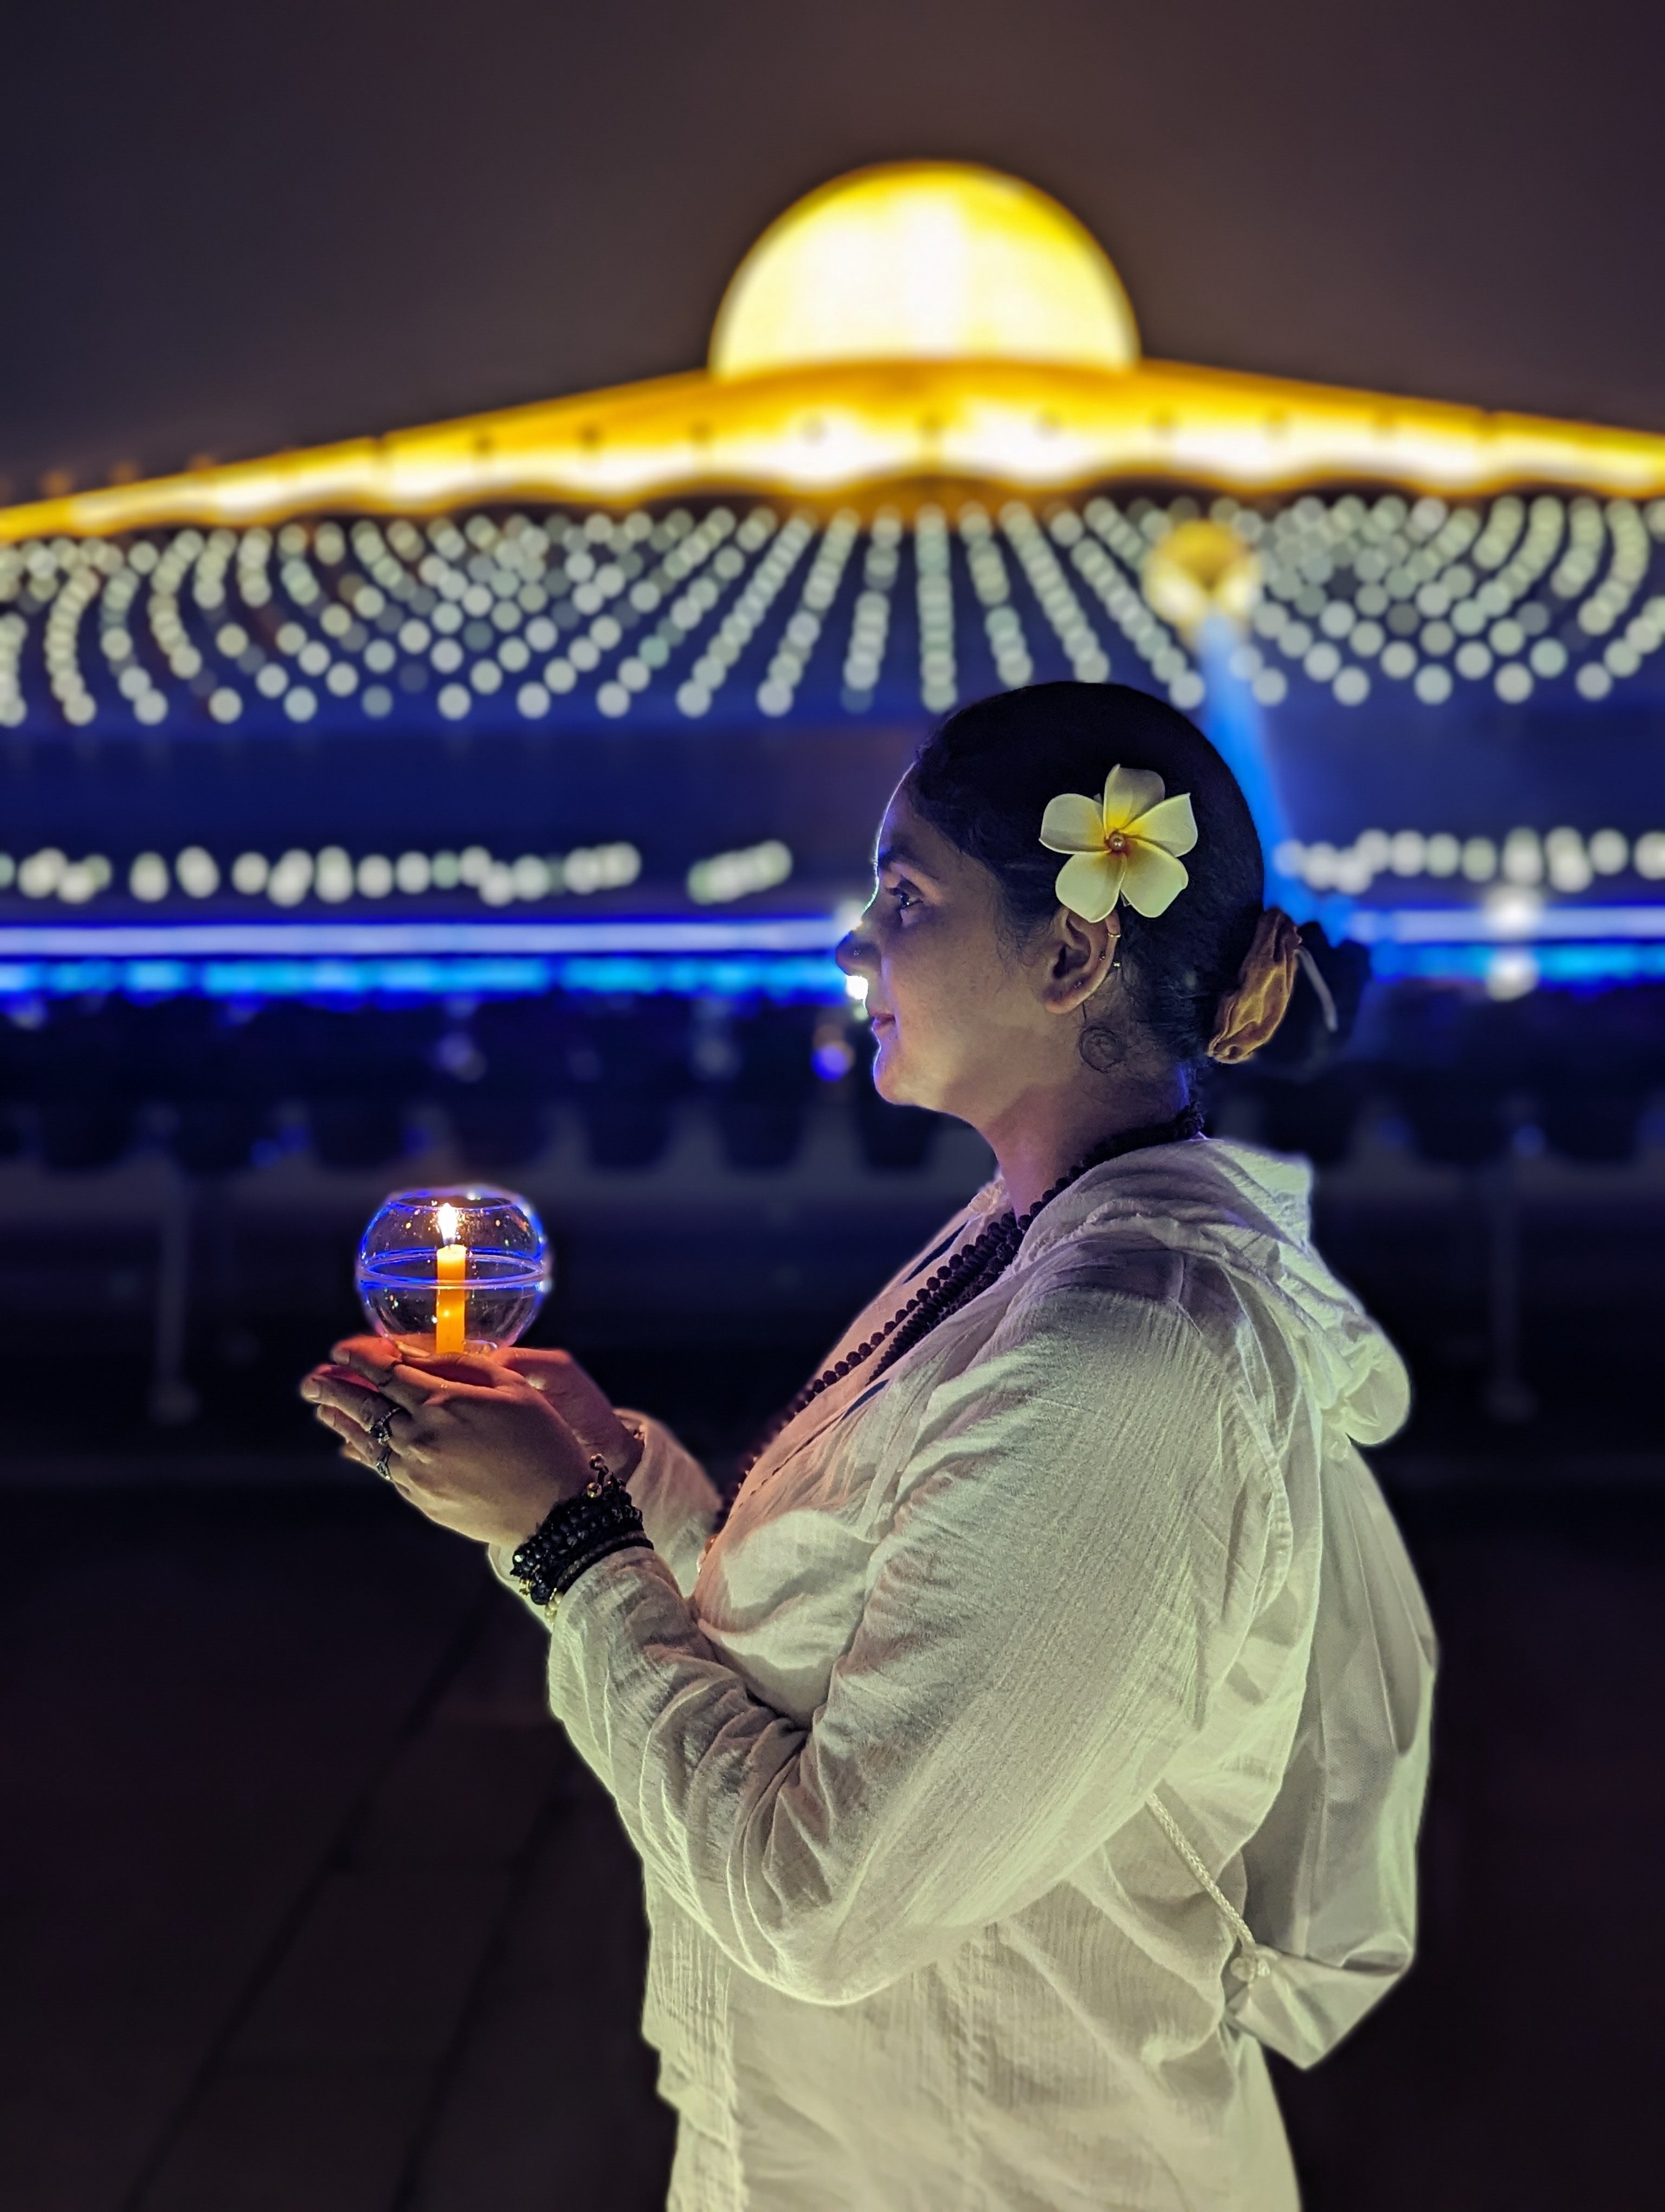
Candlelight Procession
In the evening, candelight
processions are carried out and
many people walk three times around
the main temple building. Walking
three times around represents the
Buddha, the Dhamma (teachings), and
The Sangha (Buddhist monastic
community).
(Landaw et al., Buddhism For Dummies, 2019).

Slide 16
Thai people embrace Buddhism’s compassion and wisdom. Maybe that’s why Thailand is known as
“The Land of Smiles.”
“Radiate boundless love to the entire world.” -
Buddha

Slide 17
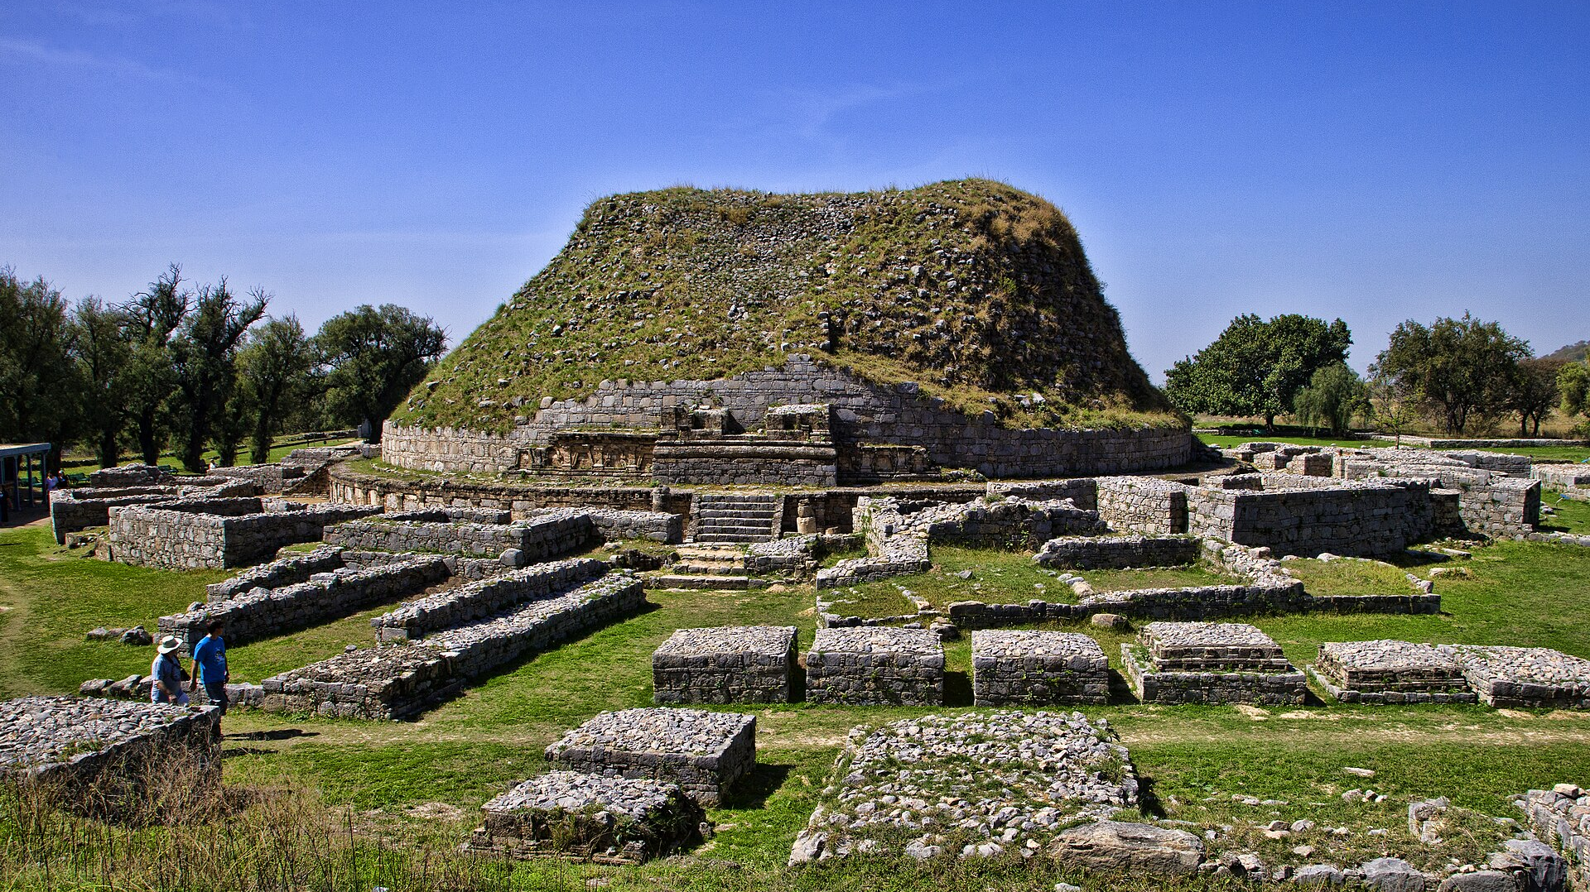
The ancient city of Taxila was a prominent
Buddhist learning centre in India.

Slide 18
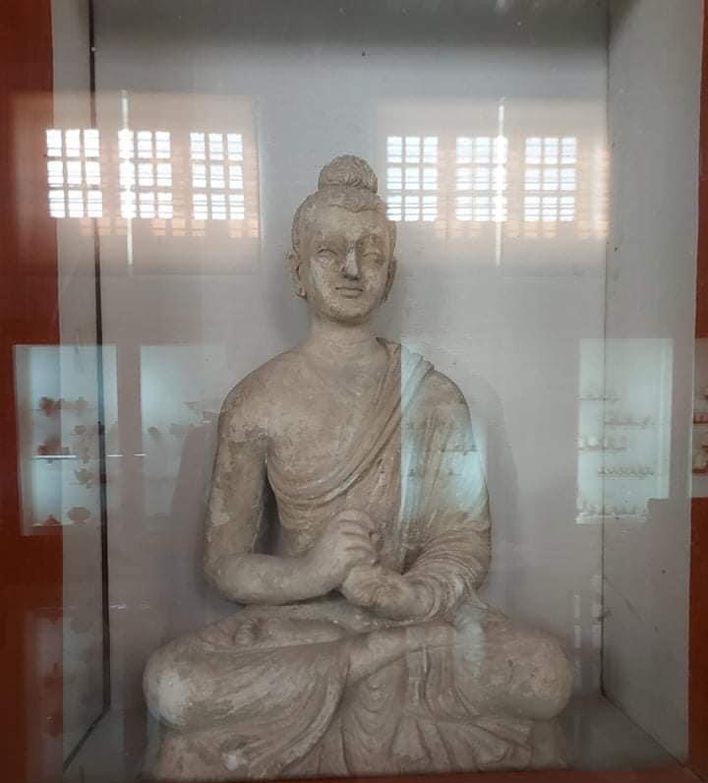
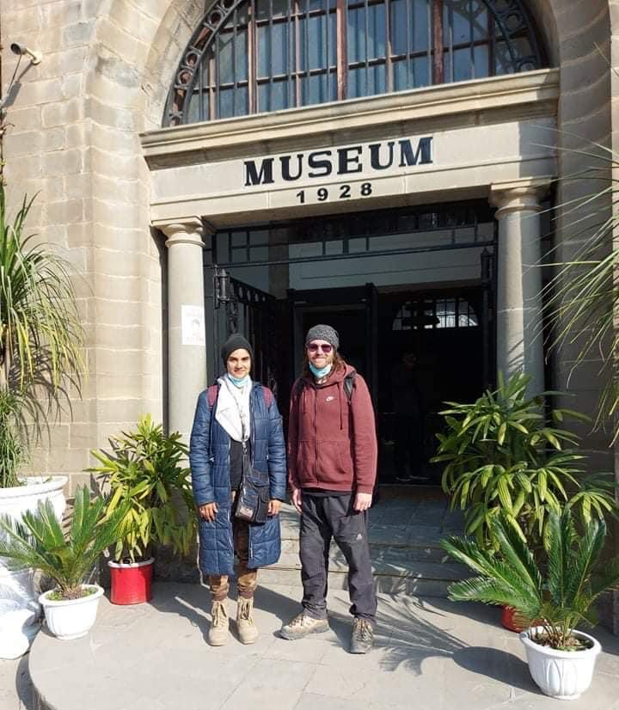
Taxila Museum has preserved many Buddhist relics.

